Slide 1
Scene-Level Multi-View
Instance Consistency
Multi-Feature Vision Fusion for Army Synthetic Ground Vehicle Evaluation
Sambit Bhattacharya, PhD · Fayetteville State University
Kyle Nakamoto, PhD · Booz Allen Hamilton

Slide 2
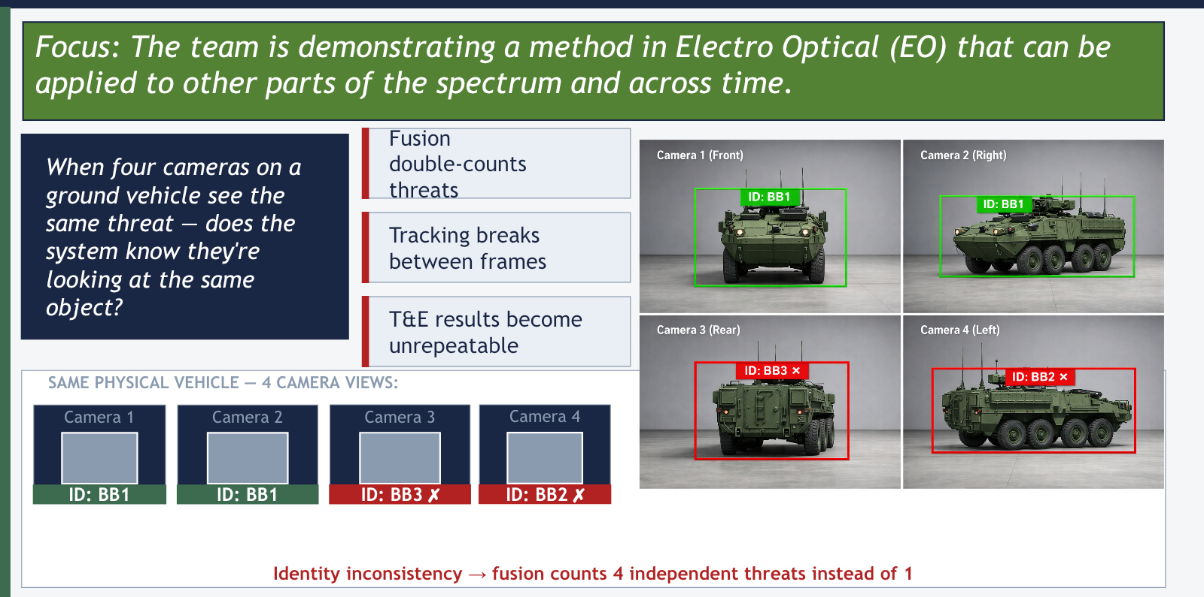
THE OPERATIONAL PROBLEM: Multi-Camera Identity

Slide 3
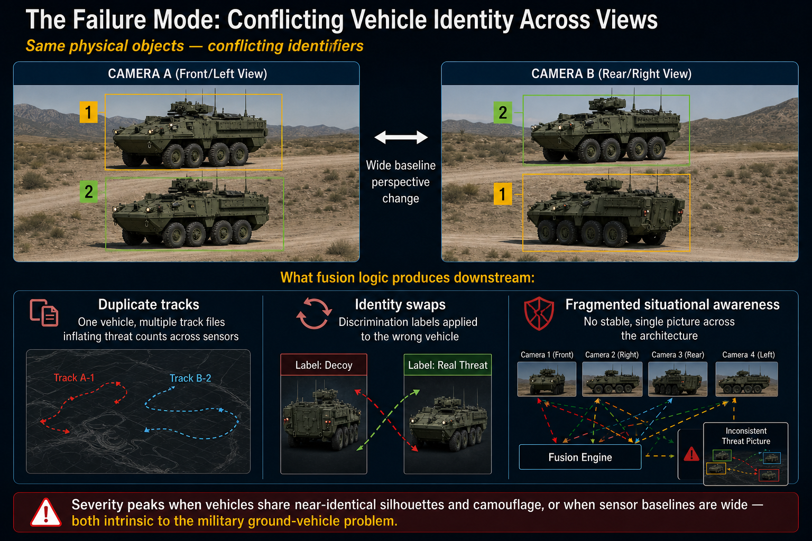
The Failure Mode: Conflicting Vehicle Identity Across Views

Slide 4
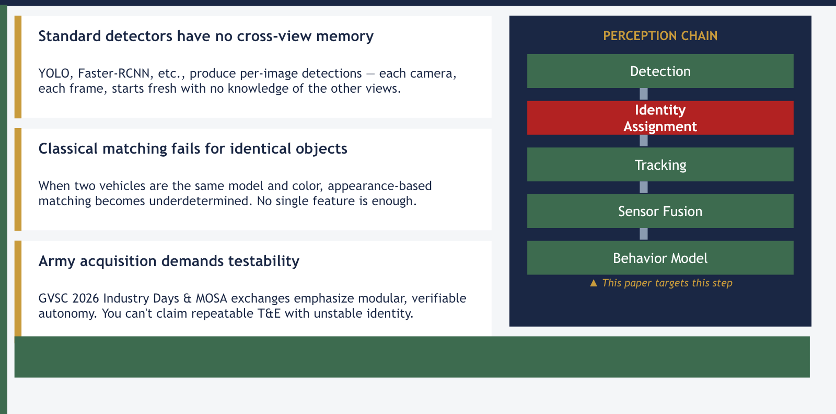
WHY EXISTING TOOLS FALL SHORT

Slide 5
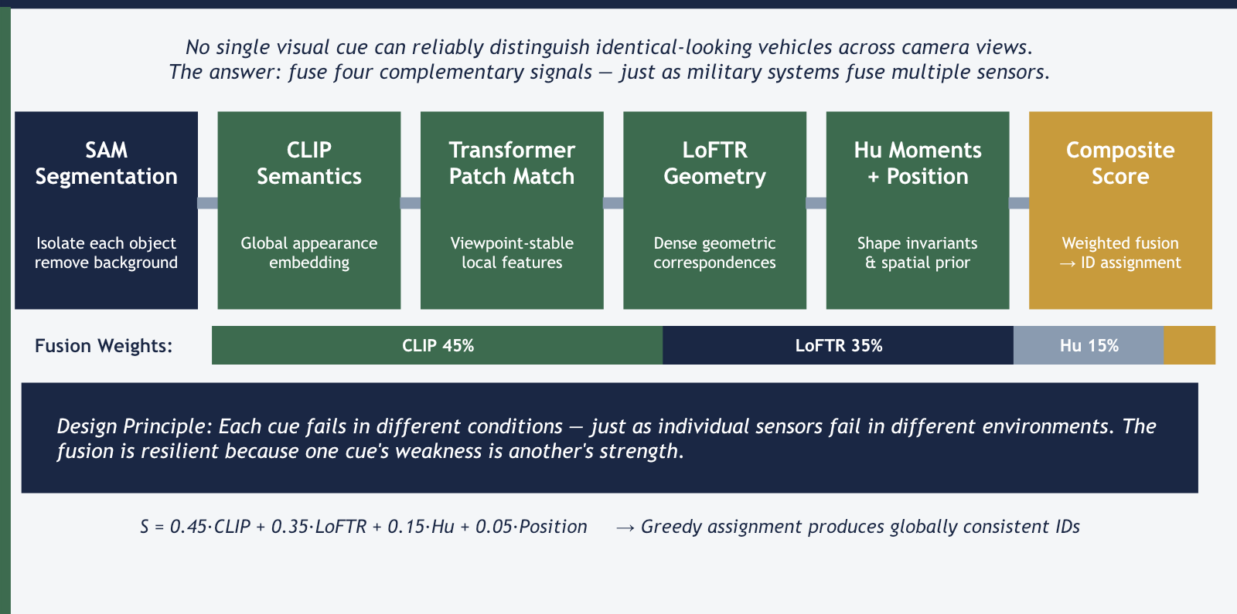
THE SOLUTION — A Multi-Feature Instance Signature

Slide 6
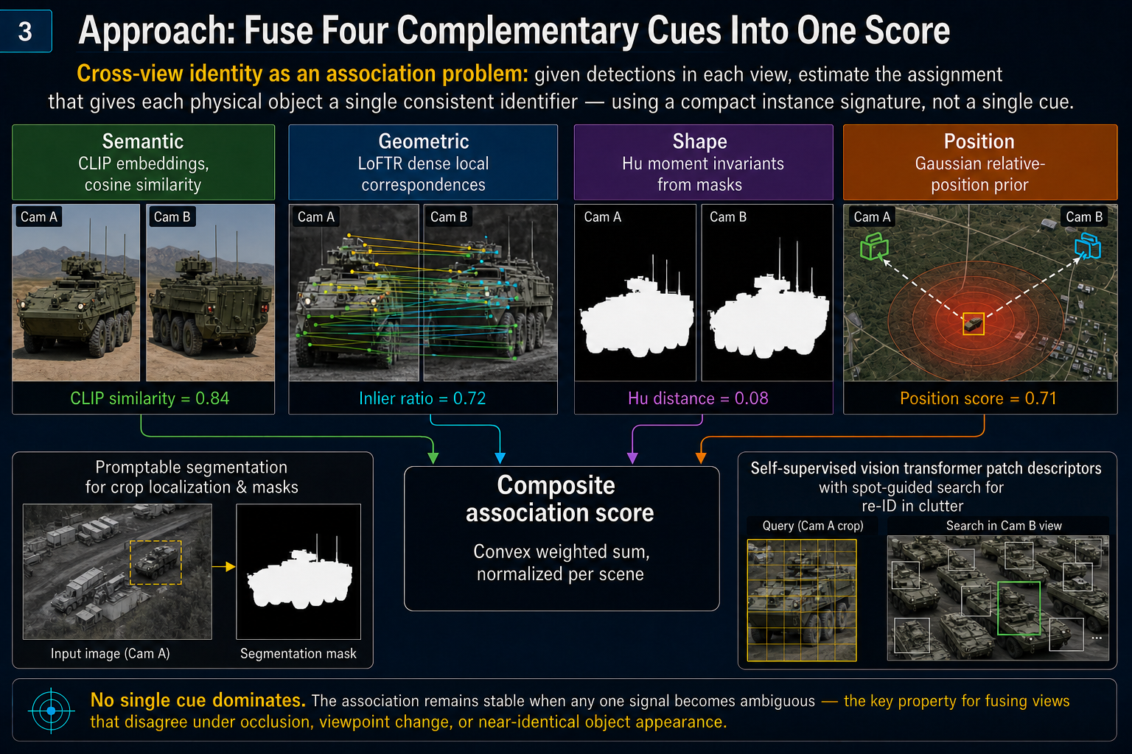
Approach: Fuse Four Complementary Cues Into One Score

Slide 7
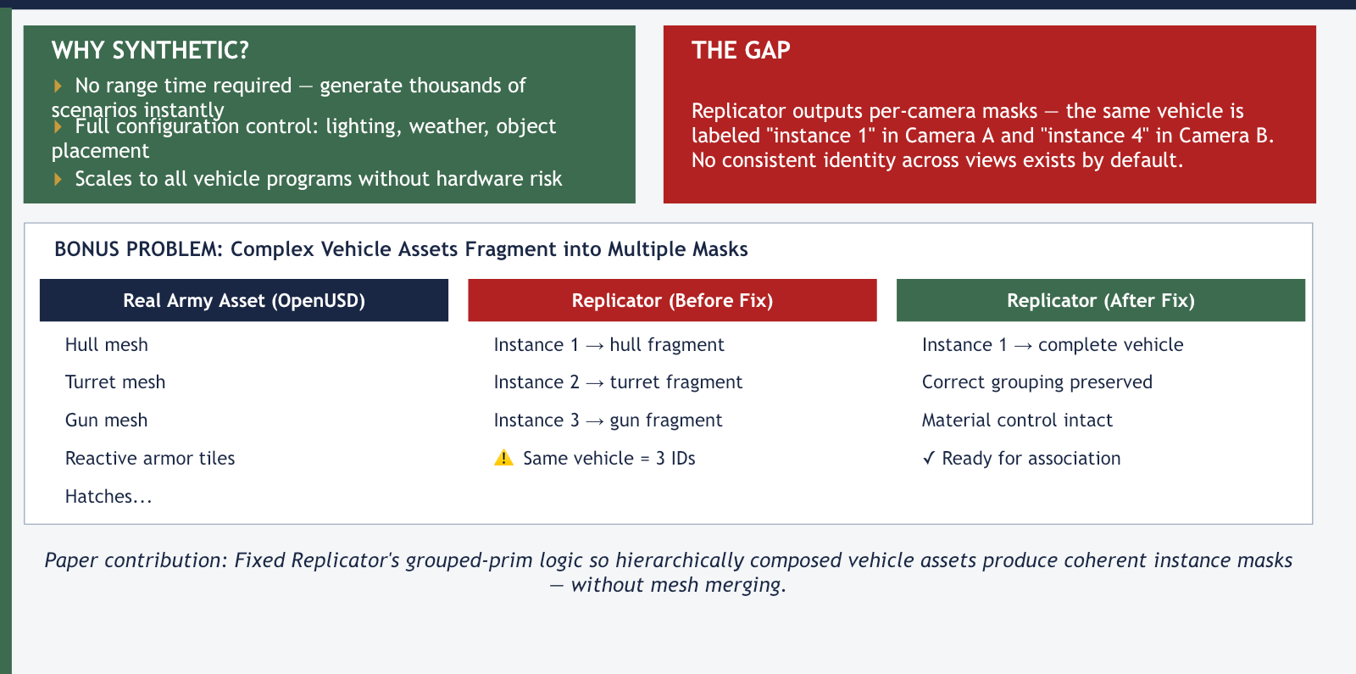
SYNTHETIC DATA: Scalable Pipeline, Broken Identity by Default

Slide 8
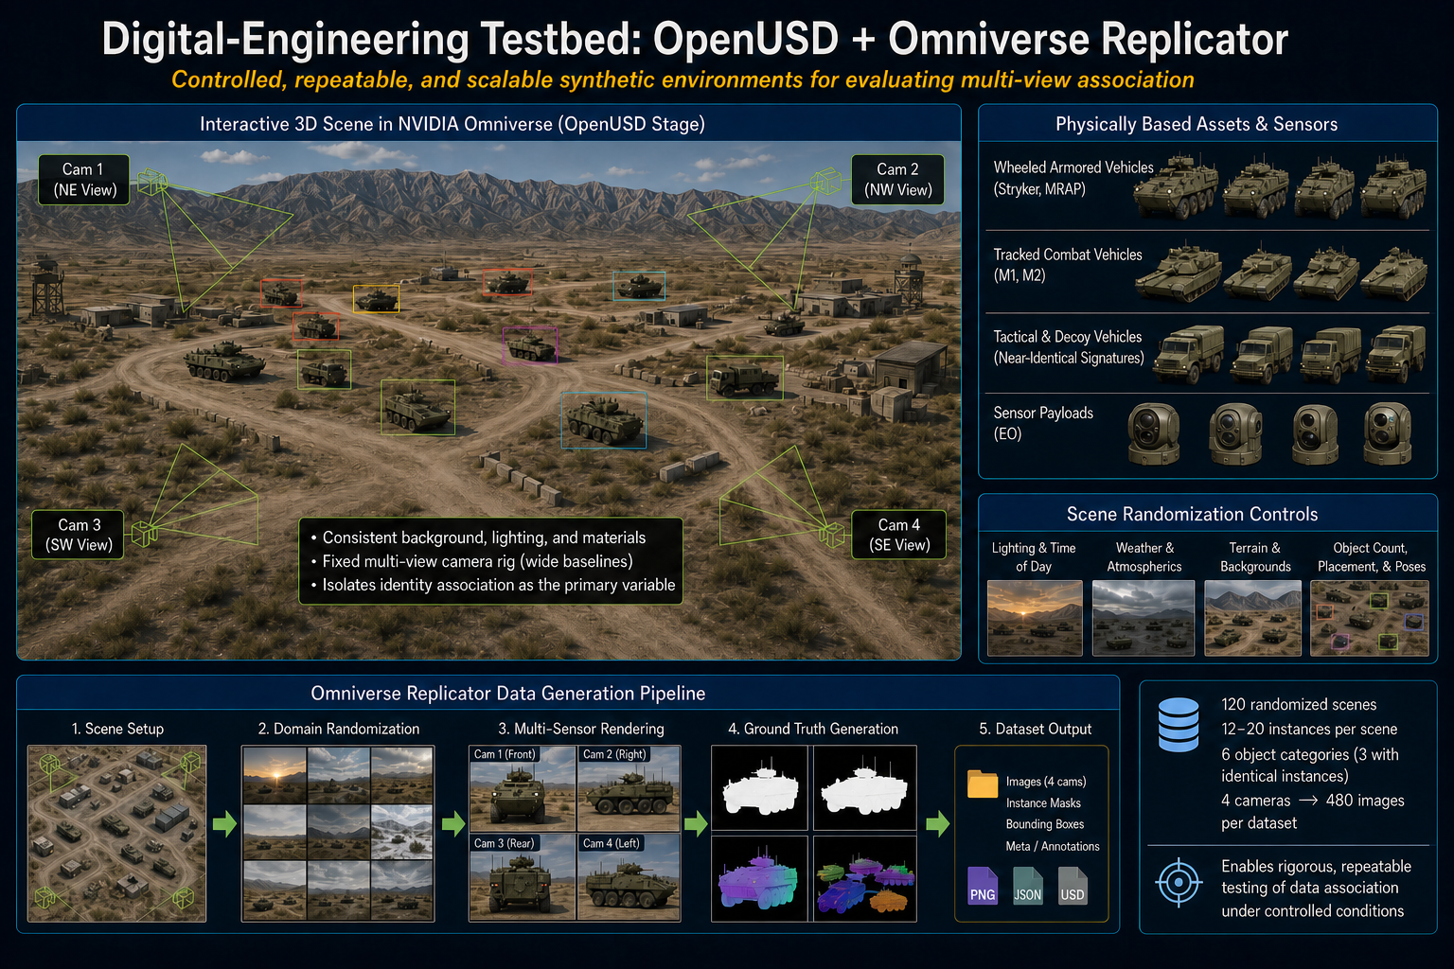
Digital-Engineering Testbed: OpenUSD + Omniverse Replicator

Slide 9
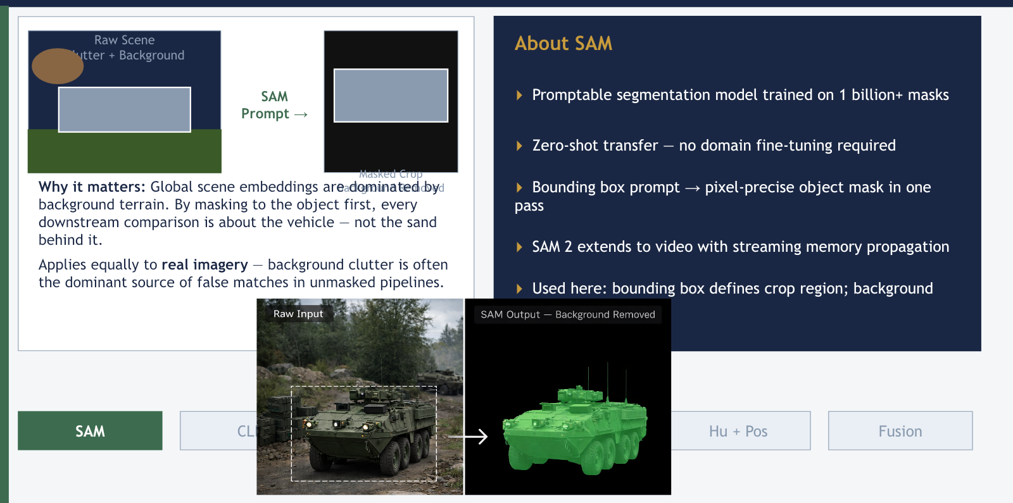
STEP 1 — SAM: Isolate the Object Before Comparing

Slide 10
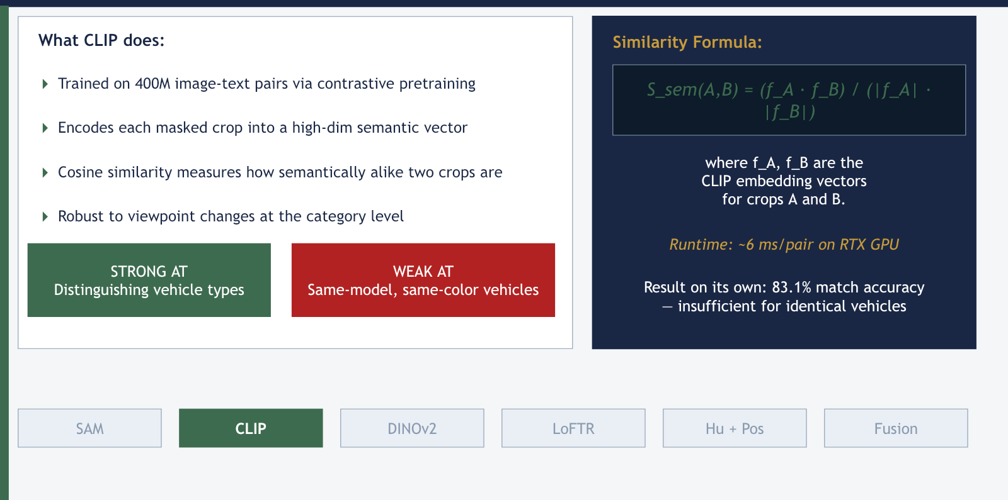
STEP 2 — CLIP: Global Semantic Similarity

Slide 11
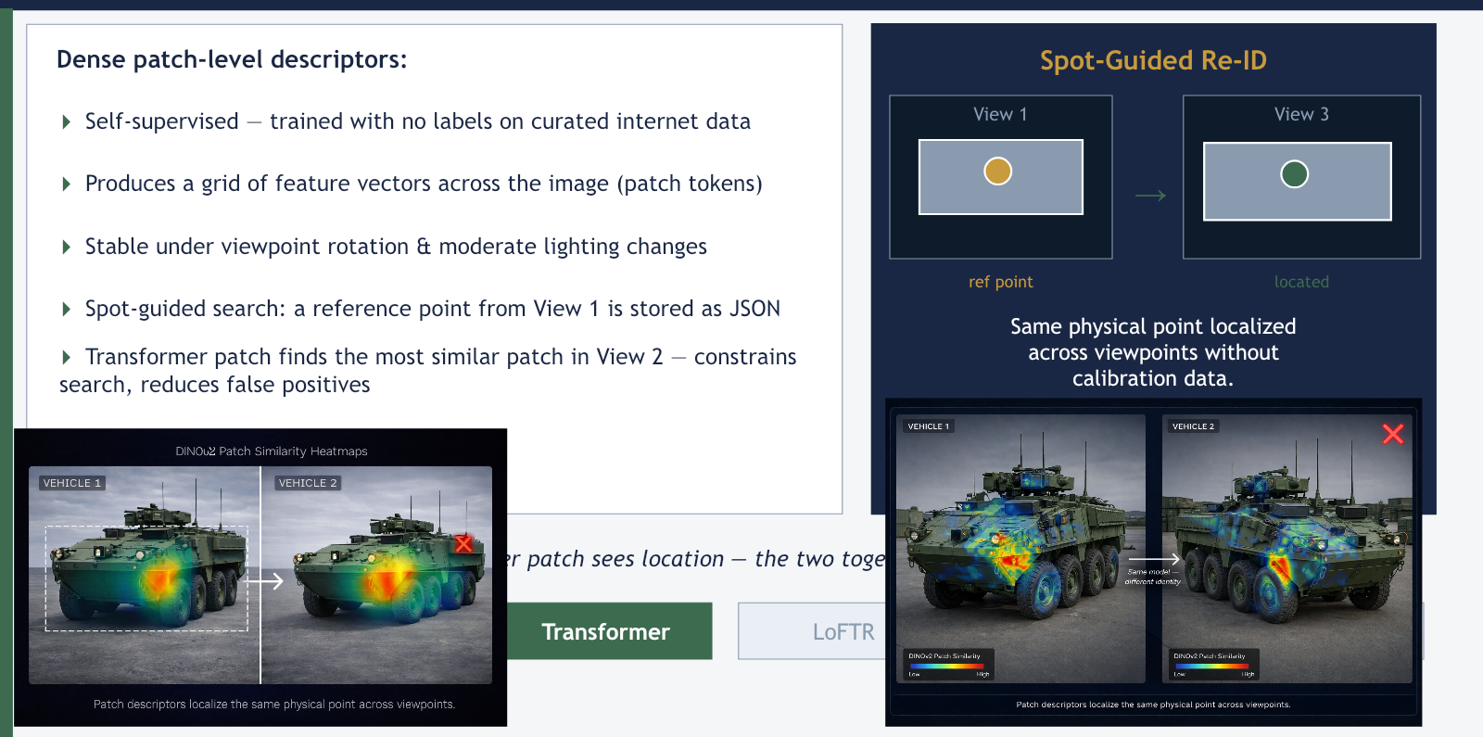
STEP 3 — Transformer: Viewpoint-Stable Local Features

Slide 12
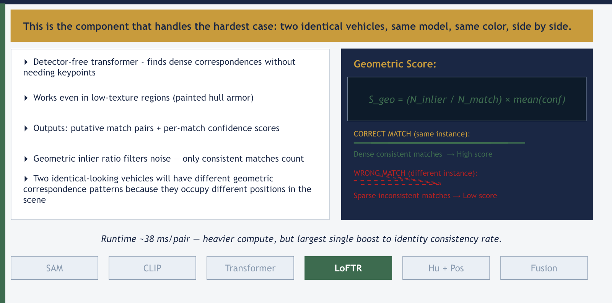
STEP 4 — LoFTR: The Tie-Breaker for Identical Objects

Slide 13
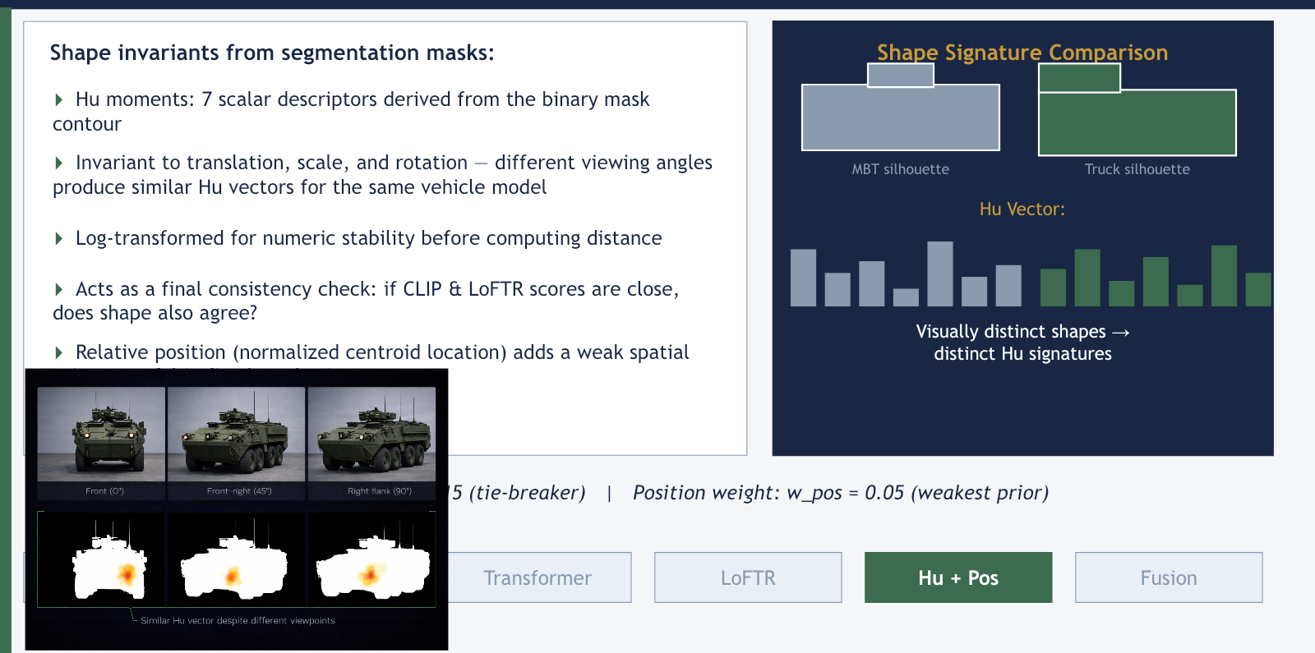
STEP 5 — Hu Moments: Shape as a Silent Witness

Slide 14
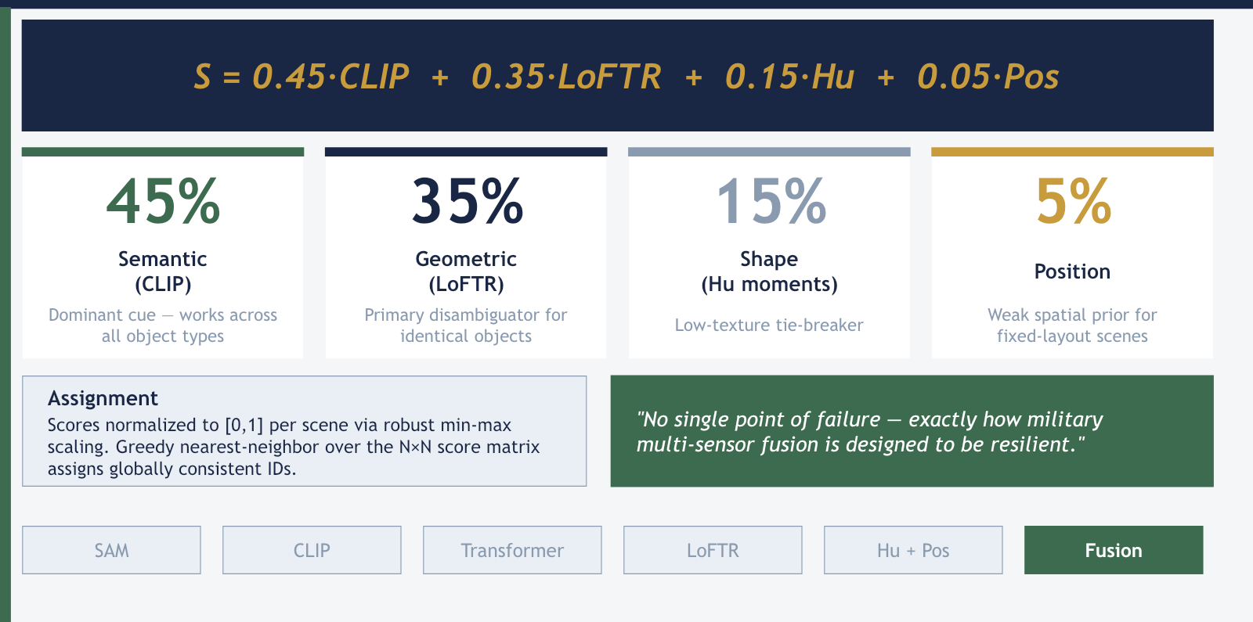
FUSION: The Composite Association Score

Slide 15
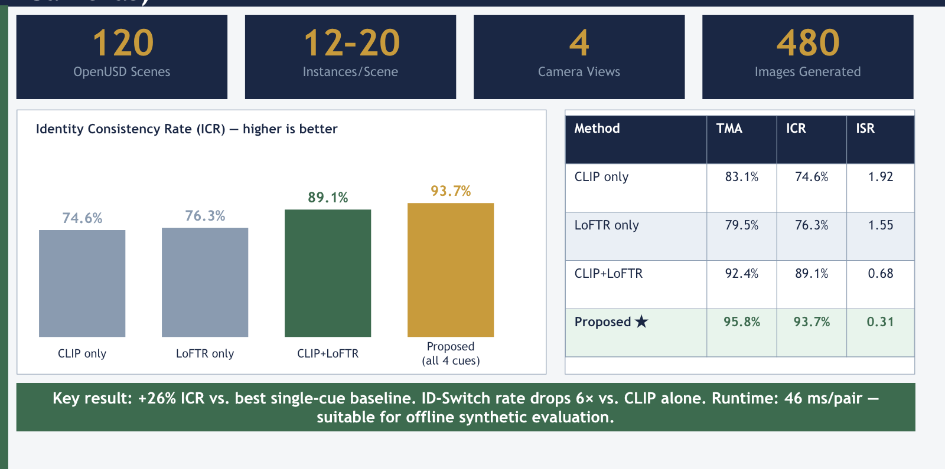
RESULTS — Synthetic Multi-View Evaluation (120 Scenes, 4 Cameras)

Slide 16
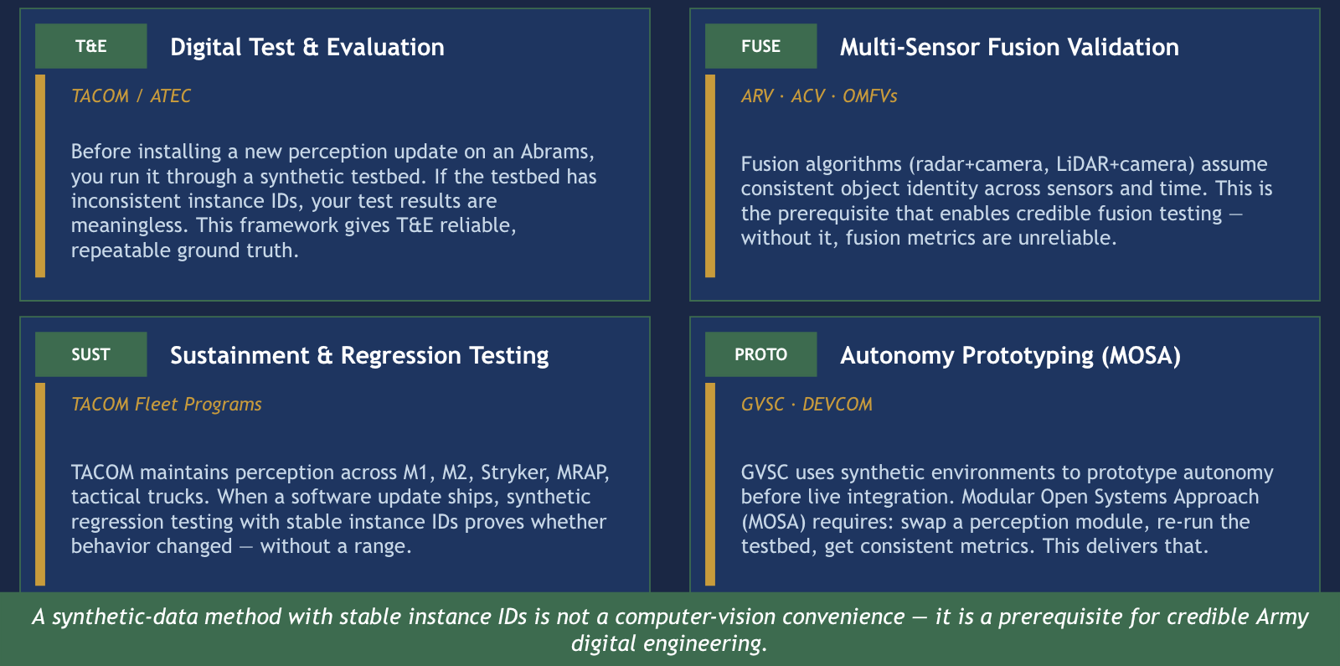
MILITARY & DEFENSE APPLICATIONS

Slide 17
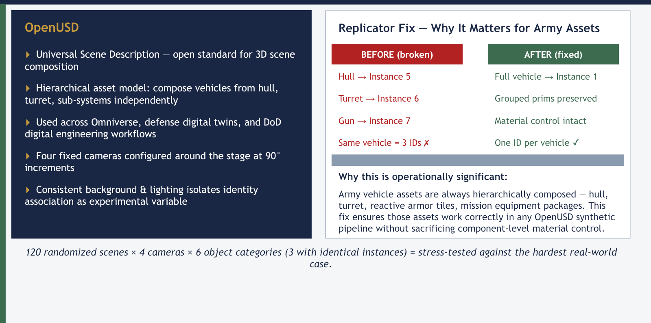
INFRASTRUCTURE: OpenUSD + Replicator

Slide 18
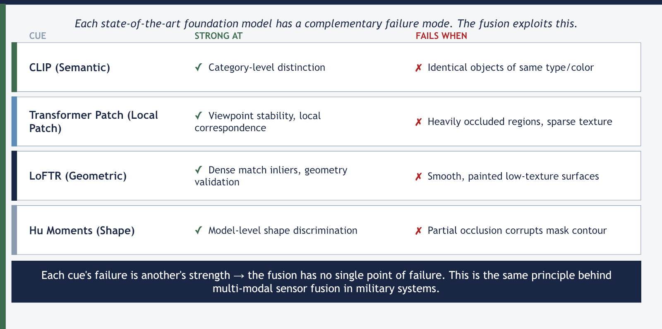
WHY NOT JUST USE ONE POWERFUL MODEL?

Slide 19
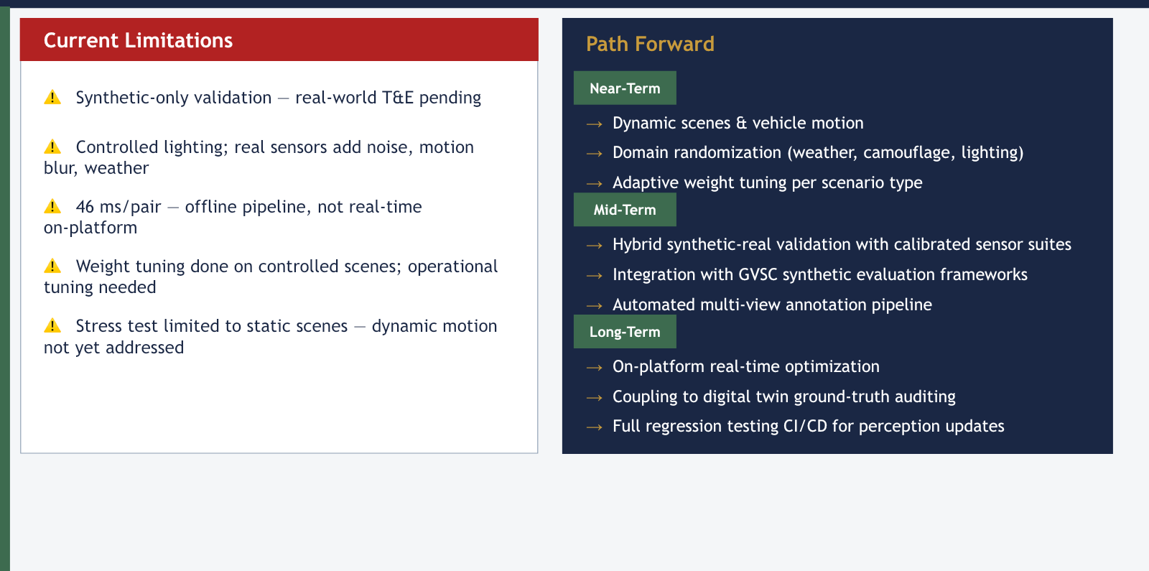
ASSESSMENT & PATH TO OPERATIONAL USE

Slide 20
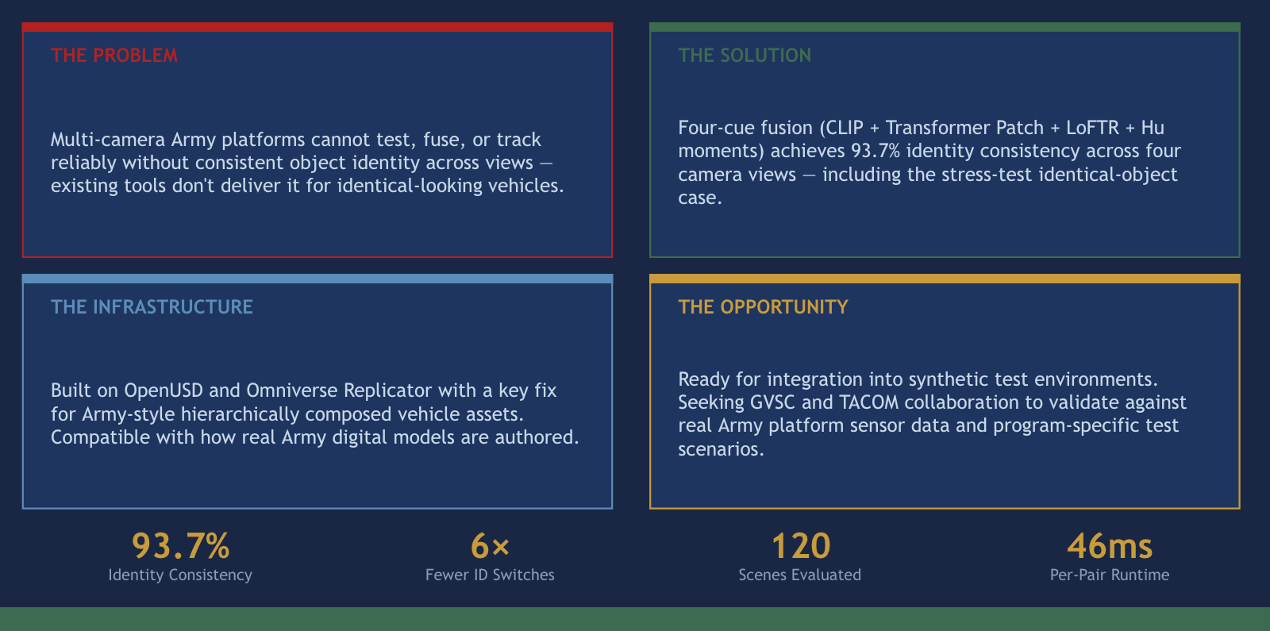
SUMMARY

